Slide 1

INTERNET OF THINGS (IoT) & APPLICATIONS (IS244AI) Experiential Learning Project Door Lock system using IoT
Faculty In-charge
Dr. G.S. Mamatha
Professor and Associate Dean
Sub In charge
B.K Srinivas
Assistant Professor
Department of ISE

Slide 2

Team Members
Ishan Gupta 1RV22IS023
Yogish HG 1RV23IS407
Amulya S 1RV23IS400
Mentors
Dr. G.S. Mamatha

Slide 3
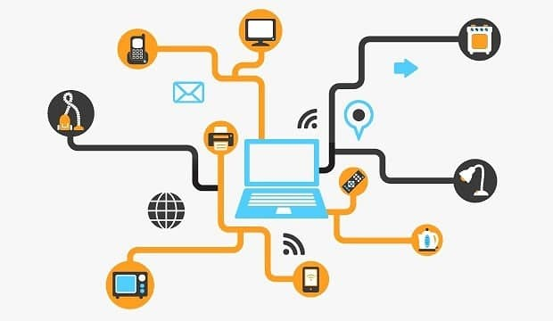
Introduction
The Internet of Things (IoT) refers to the interconnection of physical devices through the internet, allowing them to collect, share, and analyze data. This network of smart devices communicates with each other and can be remotely monitored and controlled.
It enhances efficiency, convenience, and accessibility in our daily lives and industries.
Problem statement: Traditional lock systems are limited in their capabilities and security features.
There is a growing demand for smart, connected access control solutions that offer:
Remote access and monitoring
Improved convenience and user experience

Slide 4
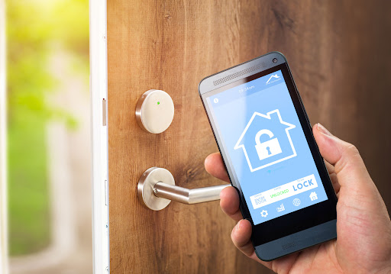
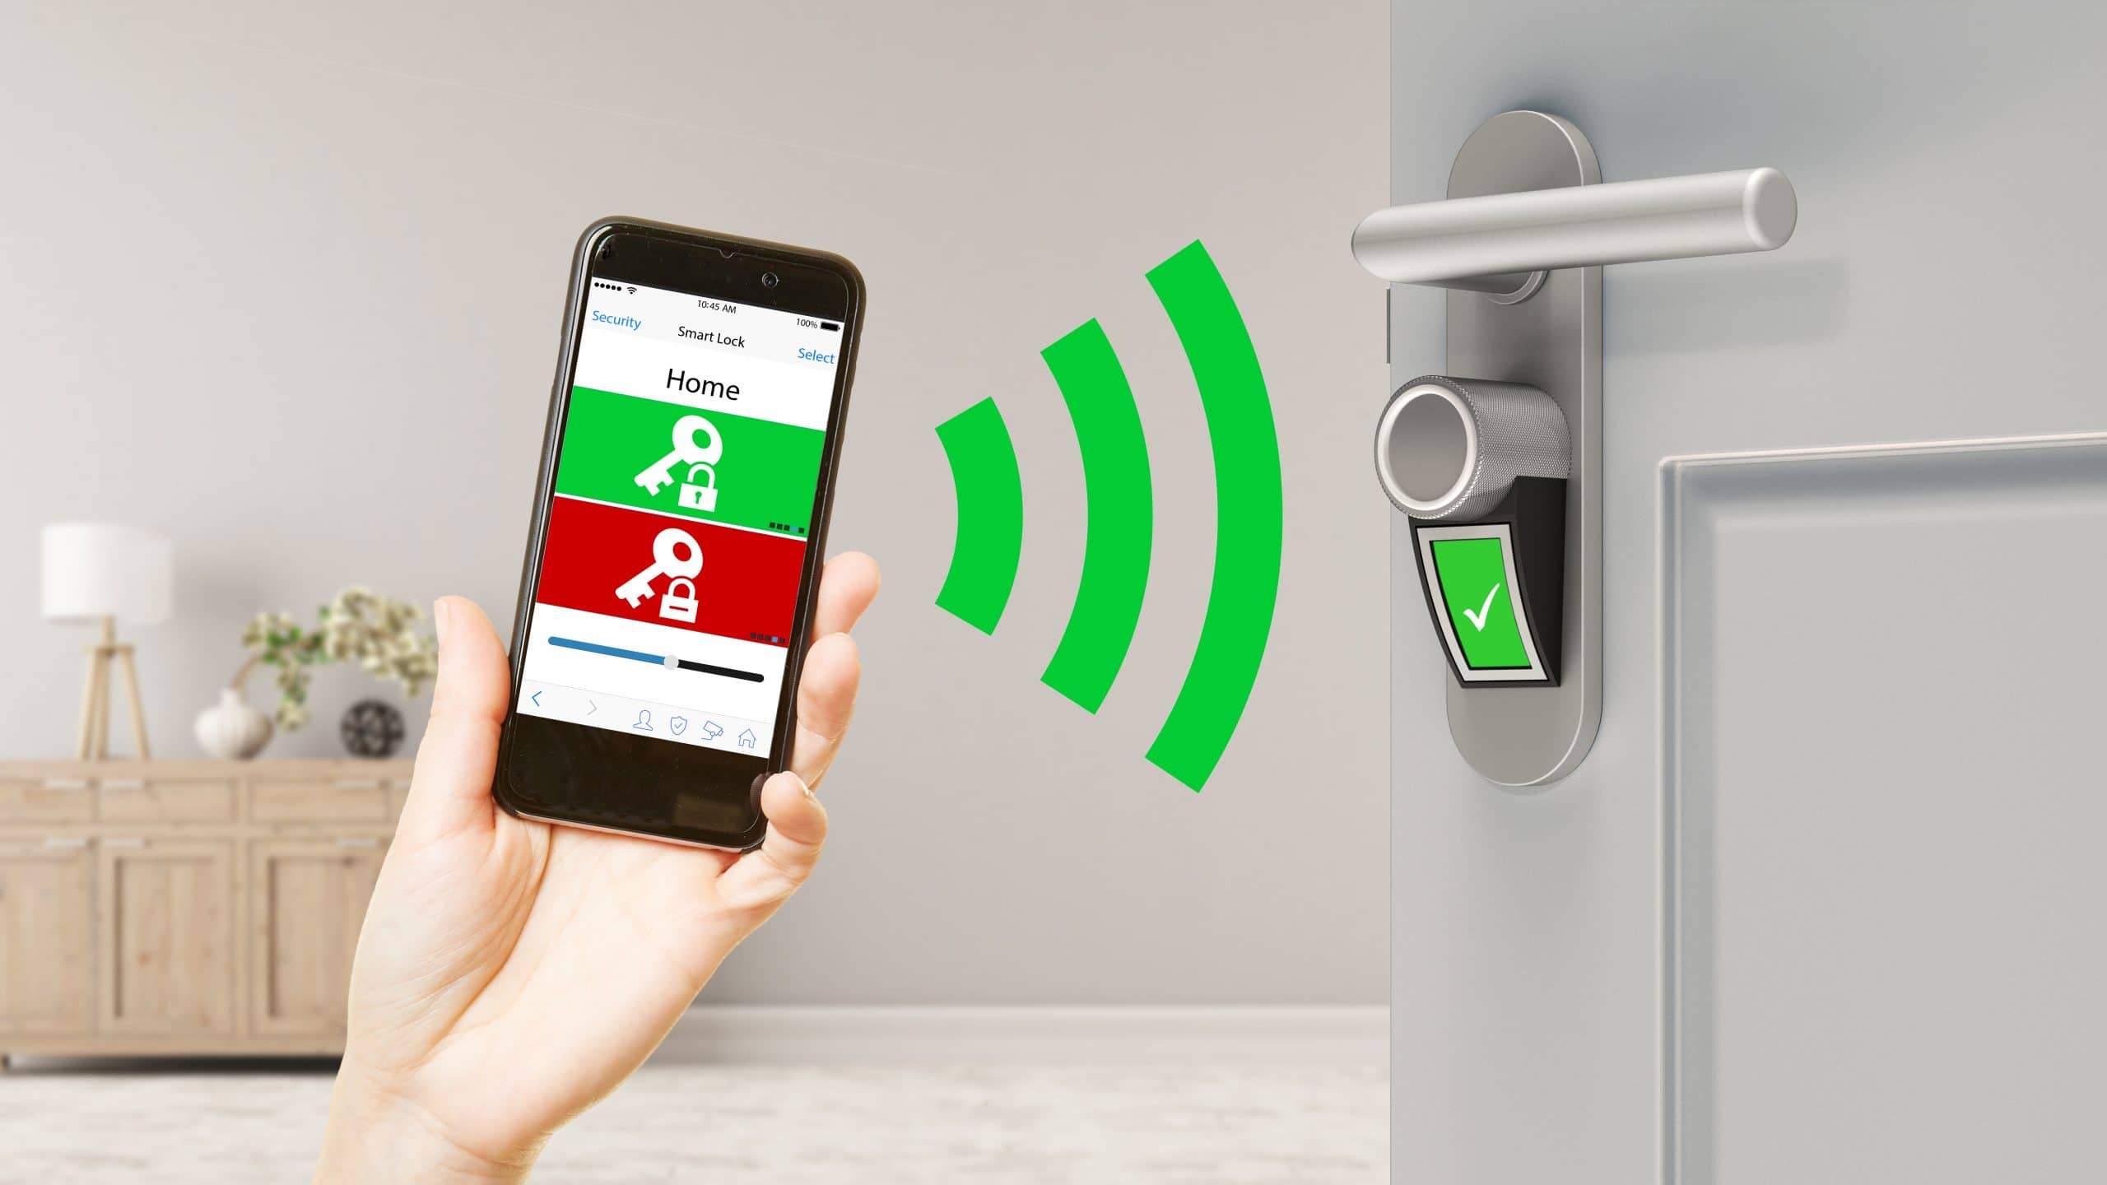
Objectives
• Develop a cost-effective, IoT-based door lock system using readily available components.
• Implement remote locking/unlocking capabilities through a user-friendly interface (Telegram).
• Integrate a camera system for visual verification and enhanced security.
• Create a scalable and customizable solution that can be adapted to various environments

Slide 5
Components
ESP32-CAM Board: A microcontroller with built-in Wi-Fi and a camera module, enabling remote control and image capture functionality.
12V Electronic Lock: An electromechanical locking mechanism that secures the door and can be activated electronically.
TIP122 NPN Transistor: A power transistor used to control the electronic lock, allowing the ESP32 to switch the lock on and off.
7805 5V Regulator: A voltage regulator that converts the 12V supply to a steady 5V output, suitable for powering the ESP32-CAM.
1N4007 Diode: A general-purpose diode used to protect the circuit from back EMF generated by the solenoid lock when it is turned off.
1k 0.25-Watt Resistor: A current-limiting resistor used to protect the base of the TIP122 transistor from excessive current.
10k 0.25-Watt Resistor: A pull-down resistor used to ensure the transistor remains off when no signal is sent from the ESP32.
100uF 25V DC Capacitor: A smoothing capacitor that helps filter voltage fluctuations and stabilize the power supply to the ESP32.
12V DC Supply: The power source providing the necessary voltage for the electronic lock and other components in the system.

Slide 6
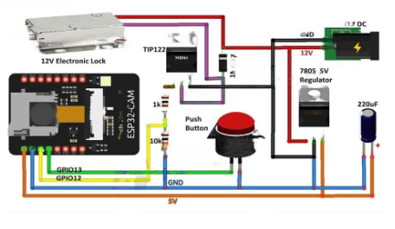
Components
ESP32 programming environment - Arduino IDE
Telegram Bot API - UniversalTelegramBot library
ArduinoJson library - Used for handling JSON data in the project
Integration with IoT platform- Thingspeak

Slide 7
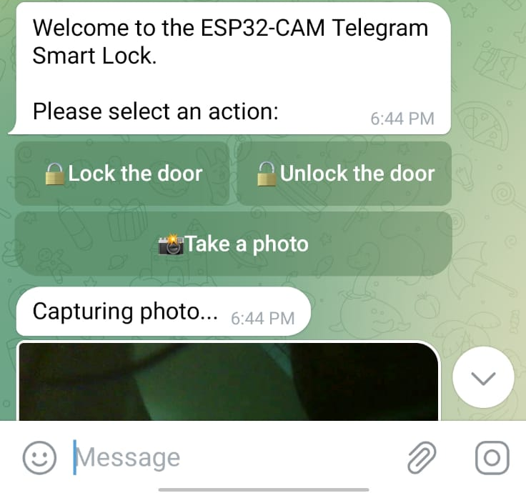
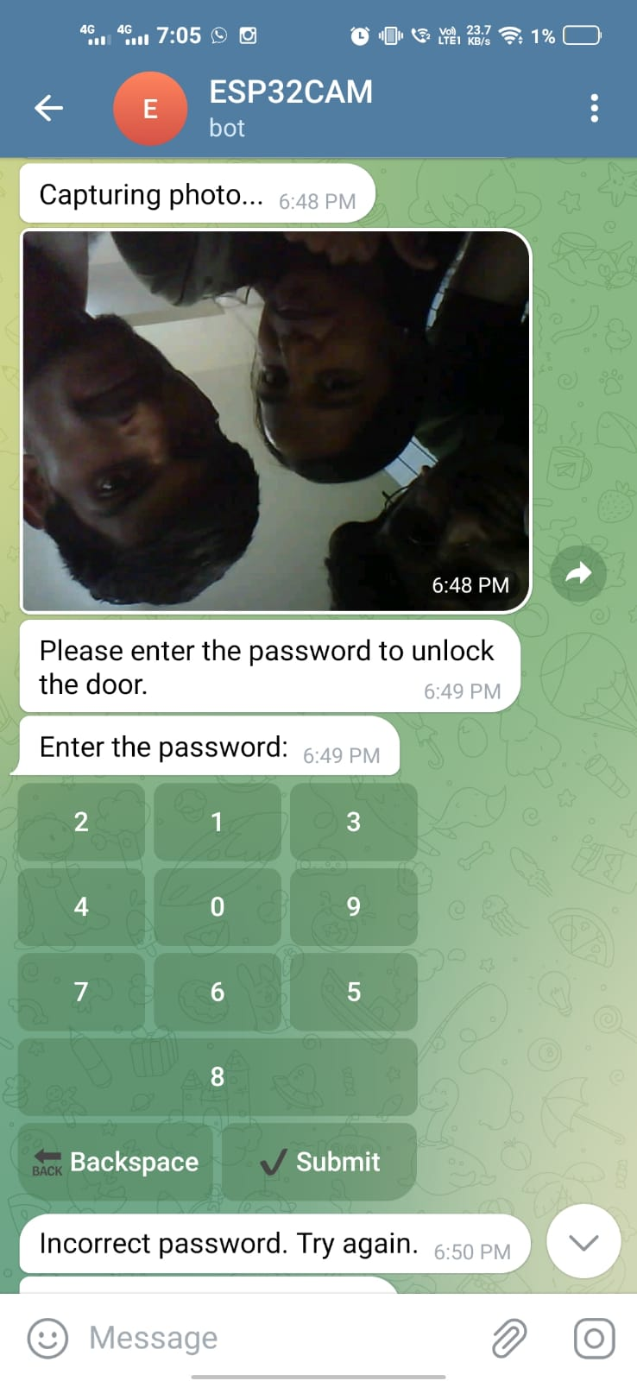
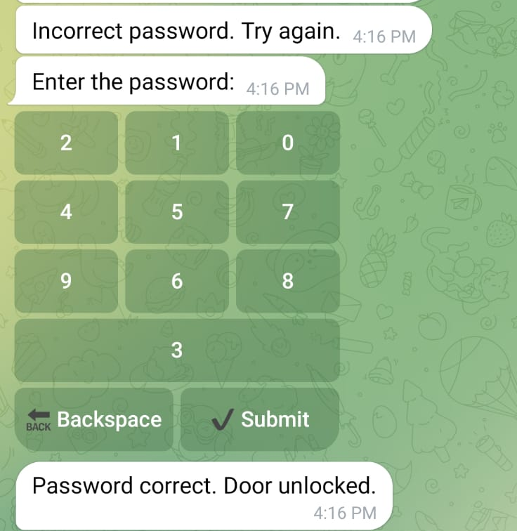
Implementation and Code
Further to be shown on IDE and demonstration

Slide 8
Demonstration

Slide 9
Future Enhancements
Facial Recognition: Integrate AI for automatic user identification, This can be done using a stronger SoC such as a Raspberry Pi 4
Multiple User Support: Allow for different access levels and permissions
Voice Control: Add compatibility with voice assistants like Alexa or Google Home
Battery Backup: Implement a failsafe power system for continuous operation
Mobile App: Develop a dedicated app for enhanced user experience
External unlocking methods: Add more unlocking methods such as interactable number lock to cover all scenarios

Slide 10
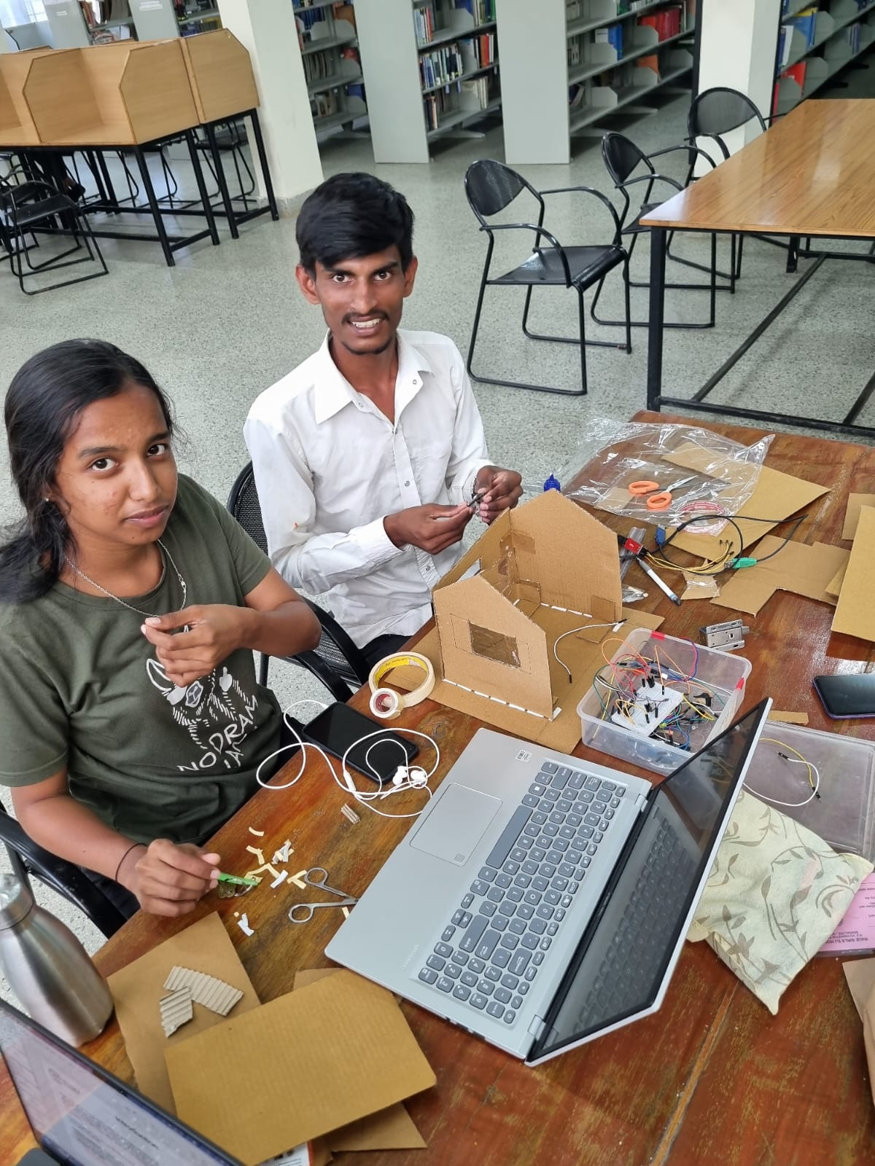
Our Learnings
Gained hands-on experience in working with IoT components like the ESP32-CAM, which combines microcontroller, wireless connectivity, and image capture capabilities.
Learned how to leverage IoT principles to create a smart, connected security system for homes and businesses.
Developed skills in interfacing hardware components (lock, sensors, etc.) with the ESP32-CAM microcontroller.
Understood the importance of proper wiring, power supply management, and troubleshooting hardware-related issues.
Enhanced programming skills by coding the ESP32-CAM using the Arduino IDE and integrating various libraries for Wi-Fi, Telegram, and image capture.
Learned about event-driven programming and state management for the lock's open/close functionality.
Gained insights into implementing secure communication between the user and the IoT system using the Telegram Bot API.
Explored authentication mechanisms to ensure the safety of the system.
Developed the capability to capture and transmit images from the ESP32-CAM upon request.
Understood the importance of providing users with instant notifications and visual feedback for enhanced security awareness.

